Slide 1
EDA Case Study SUBMISSION
Group Facilitator –Poornima P

Slide 2
Identification of driving variables behind loan default
A consumer finance company (largest online loan marketplace) which specialises in lending various types of loans to urban customers wants to understand the patterns to identify if a person is likely to default. This can help them take actions beforehand like denying the loan, reducing the amount of loan, lending at a higher interest rate, etc.
We are trying to look at both the consumer attributes and loan attributes influence the tendency of default from the past data available . This can help the company reduce the credit loss. Identification of such applicants using EDA is the aim of this case study.

Slide 3
Problem solving methodology
Understanding the business objective
Domain Understanding
Analysis
Data Loading from csv to python dataframes and identification of attributes
Data Cleaning and Manipulation
Checking for Missing values
Deletion of unnecessary columns
Conversion of incorrect datatypes
Validation of internal rules
Outlier treatment
Univariate Analysis
Segmented Univariate Analysis
Bivariate Analysis
Conclusions and Presentation

Slide 4
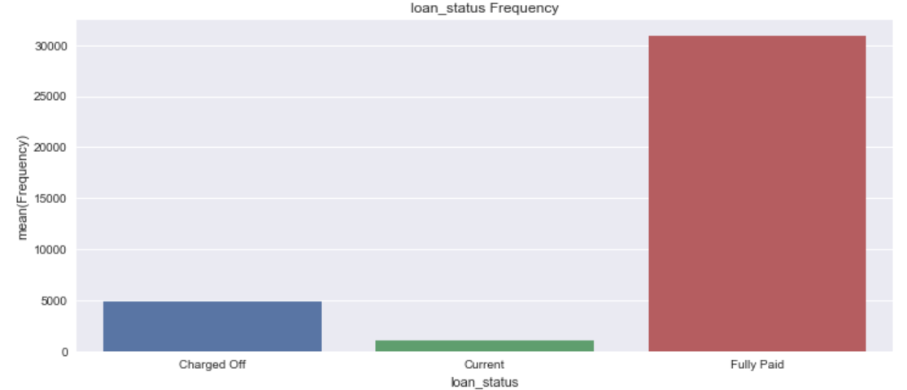
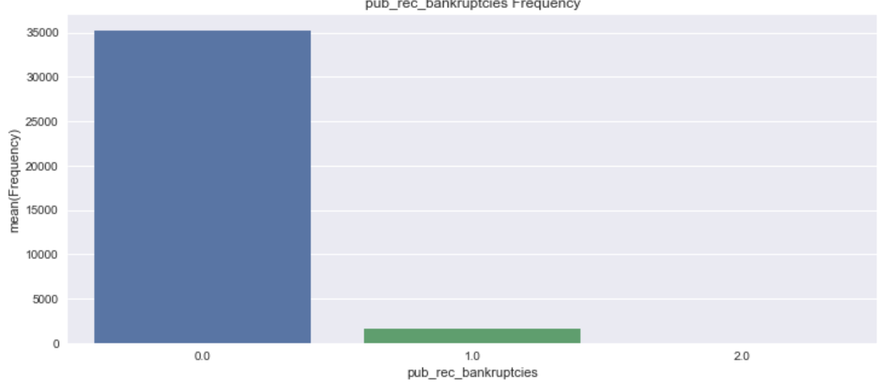
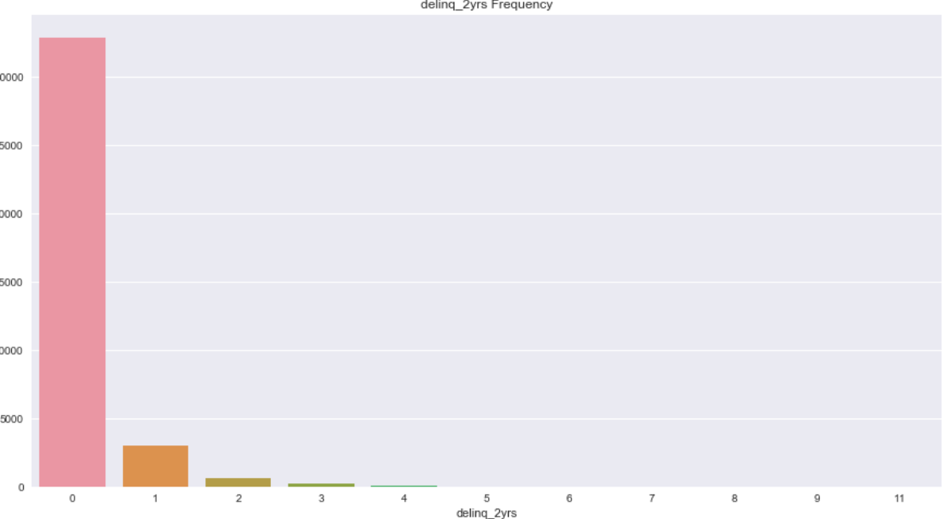
Univariate Analysis
Unordered categorical variables-
One of 6 loans is charged off (defaulted)
Most records have 0 bankruptcy record
Delinquency in the past 2 years and loan status seems to have a pattern. Customers with past-due incidences of delinquency may fall towards charged_off category

Slide 5
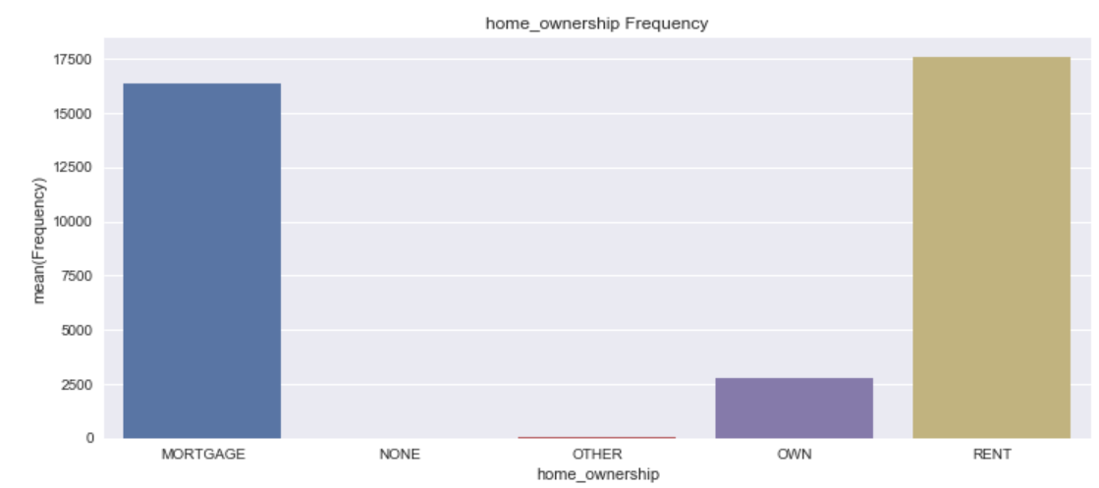
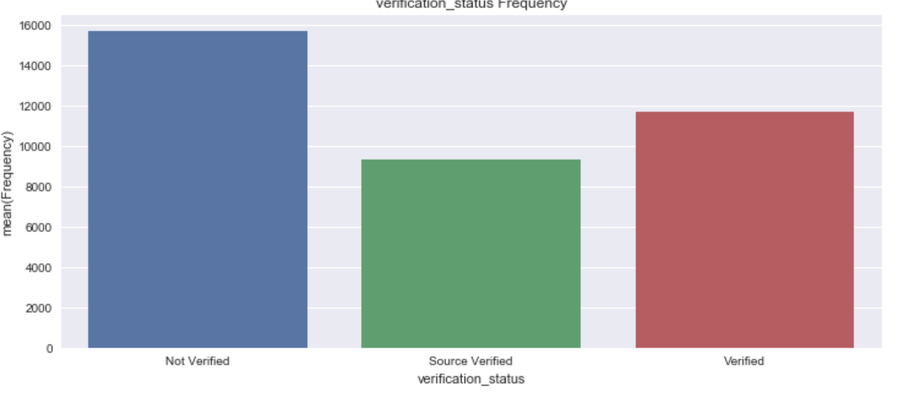
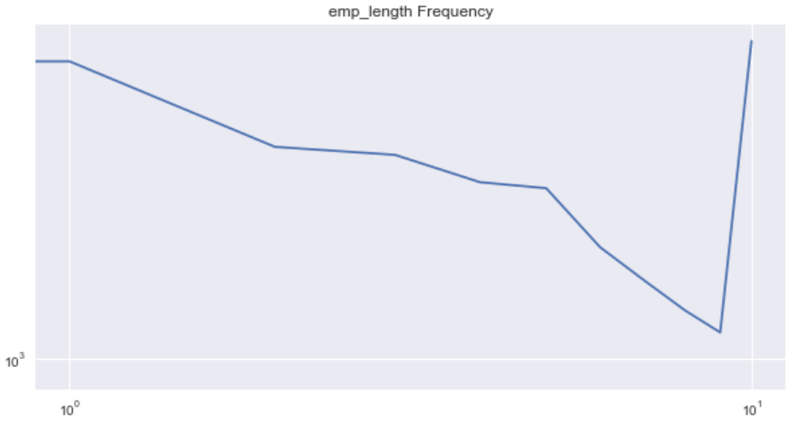
Univariate Analysis
Employment length of 1 and 10 have most loan requests and the graph and the graph slopes down from 1 till 9

Slide 6
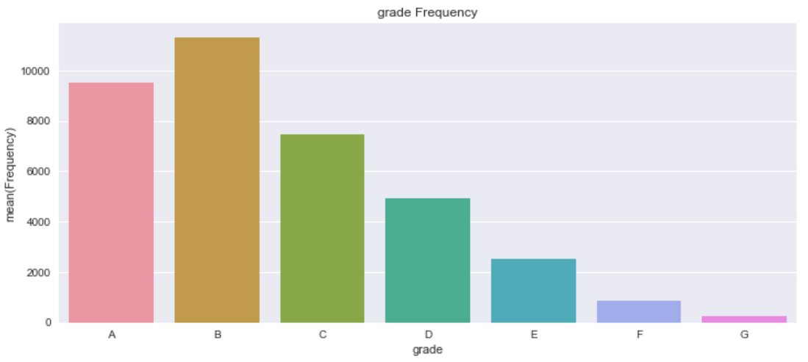
Univariate Analysis
Most customers fall under grade ‘B’ followed by grade ‘A’

Slide 7
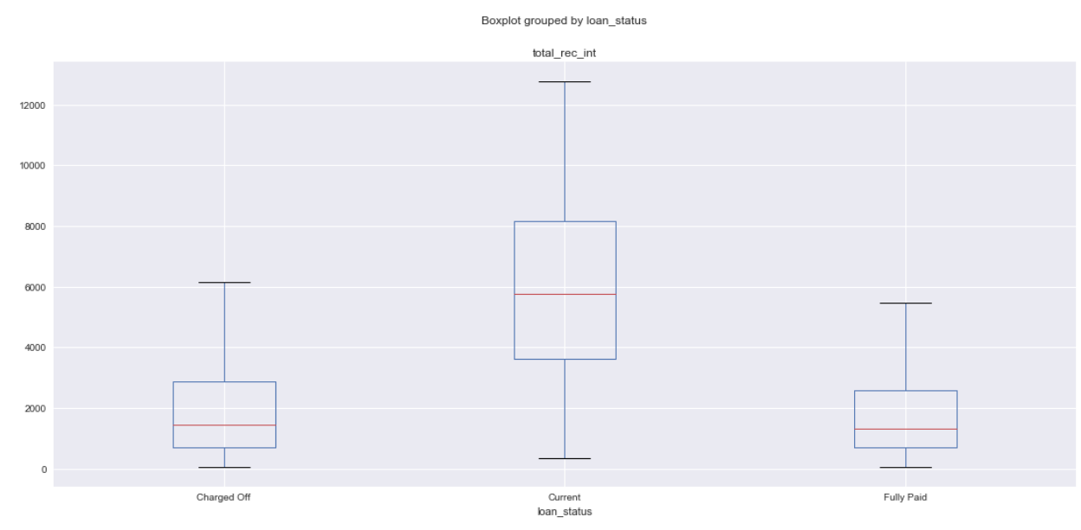
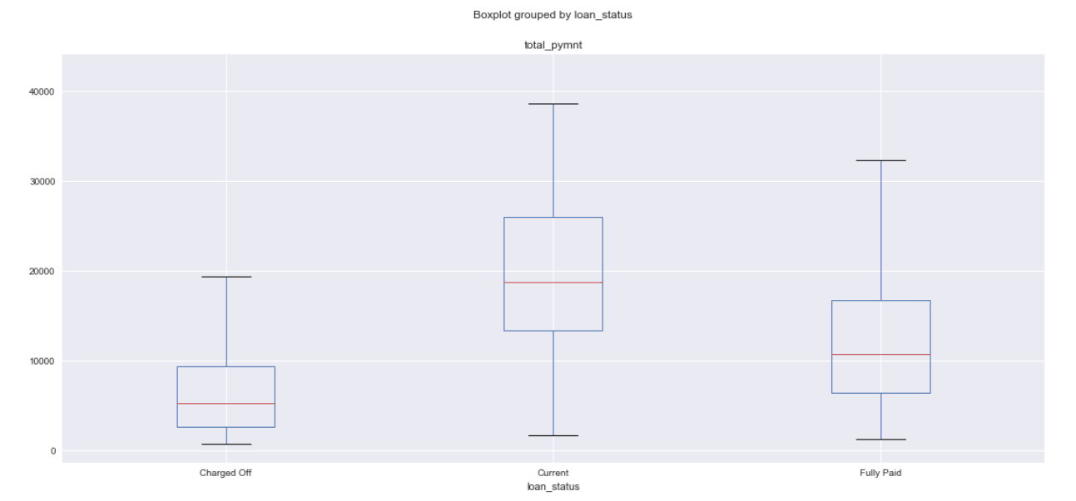
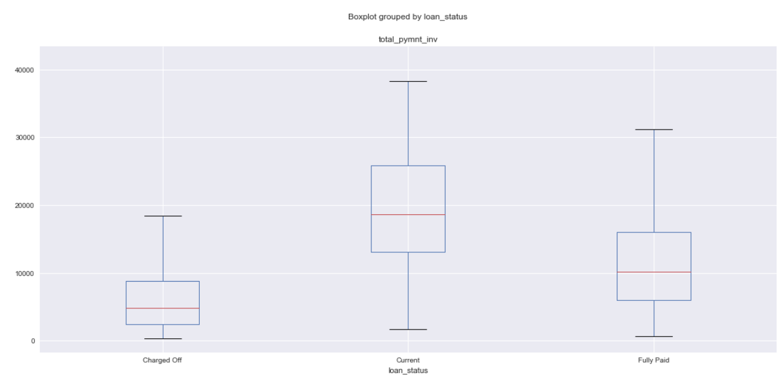
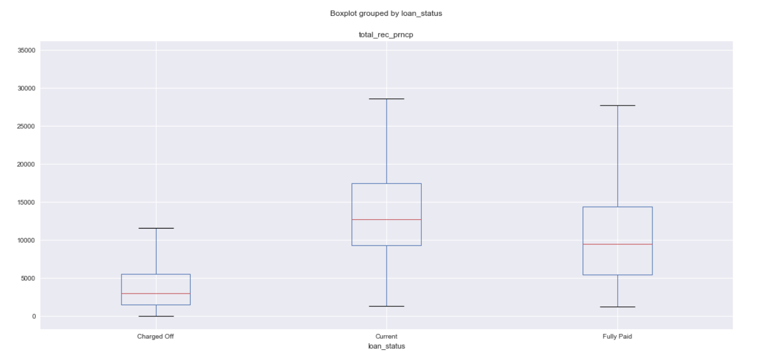
Analysis
Loan with lesser repayment are charged Off and loan with higher repayment are either in progress or fully paid

Slide 8
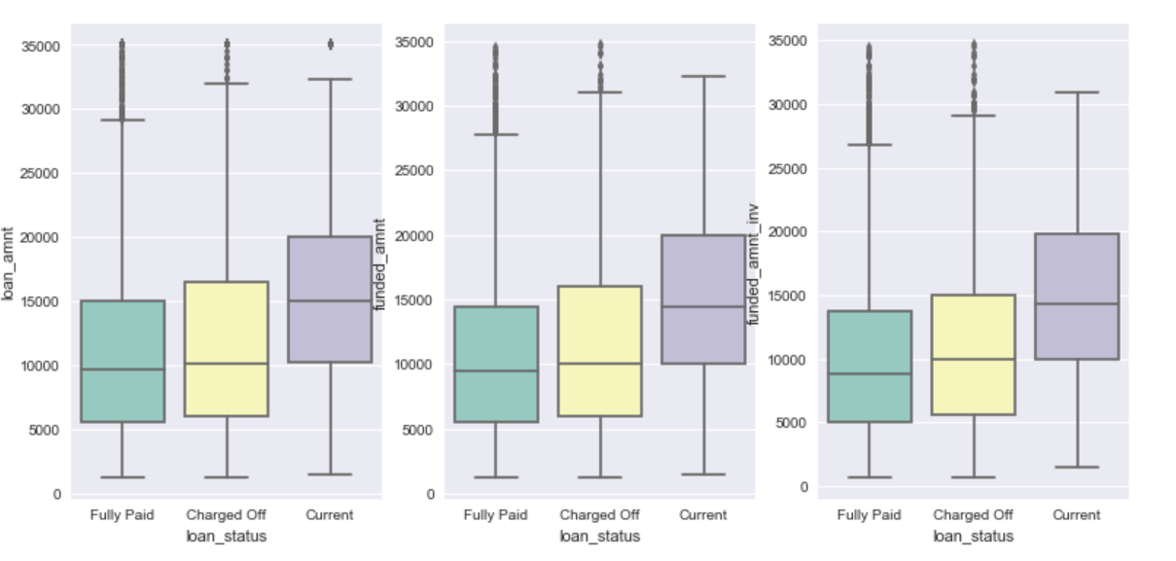
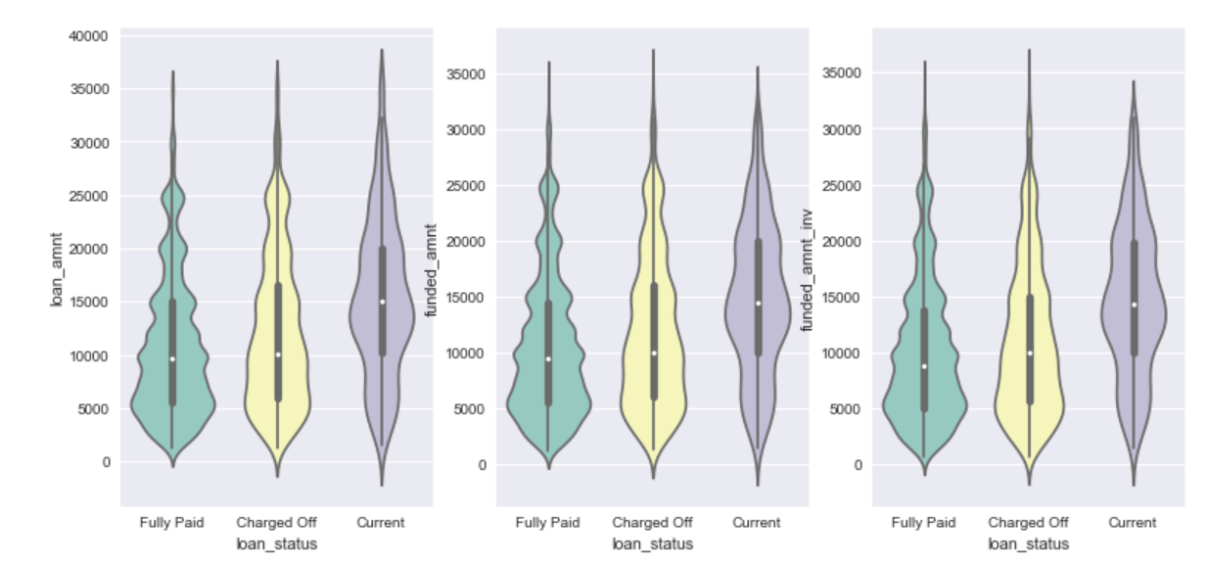
Segmented Univariate Analysis
Analysis on loan amount when applied by the borrower (loan_amnt), committed (funded_amnt) and committed by investors (funded_amnt_inv)
95% times the applied loan amount is funded. But only 50% of times the investors amount is same as funded amount.
There is no significant difference in data when it comes to difference in loan amount when applied and funded

Slide 9
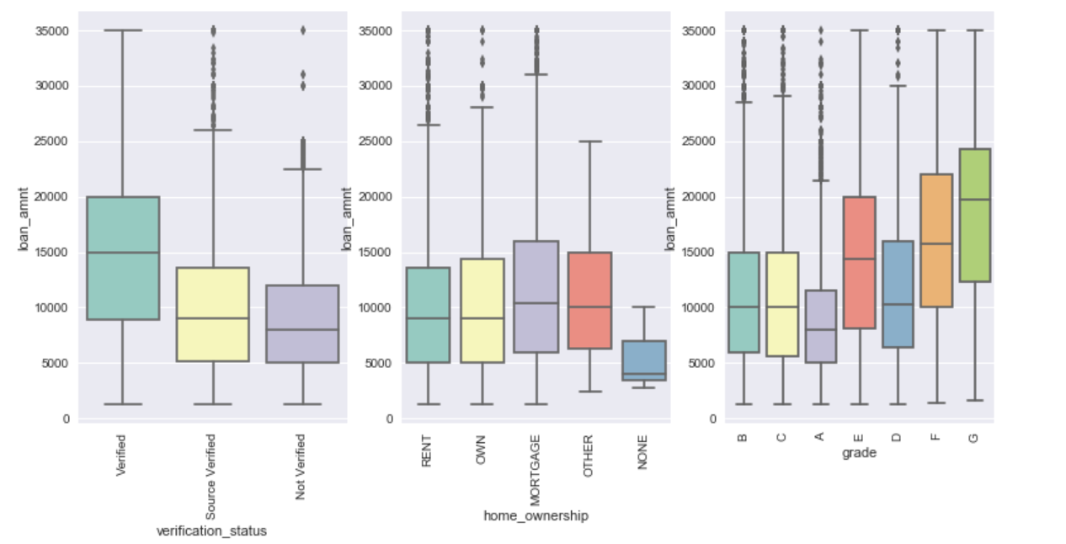
Segmented Univariate Analysis
Verification status:
1.1 If the verification status is verified, the average loan amount is higher
1.2 If the verification status is verified, the range of loan amount is also high
Home Ownership:
2.1 Home ownership with Mortgage has the highest loan amount
2.2 Home ownership with Rent and Own have similar median and range of loan amount and less when compared to Mortgage
3. Grade:
3.1 Grades E and F have large range of loan amount when compared to others.
3.2 Grade A has a lower median compared to others. However there are quite a lot of loans that fall above the upper IQR range

Slide 10
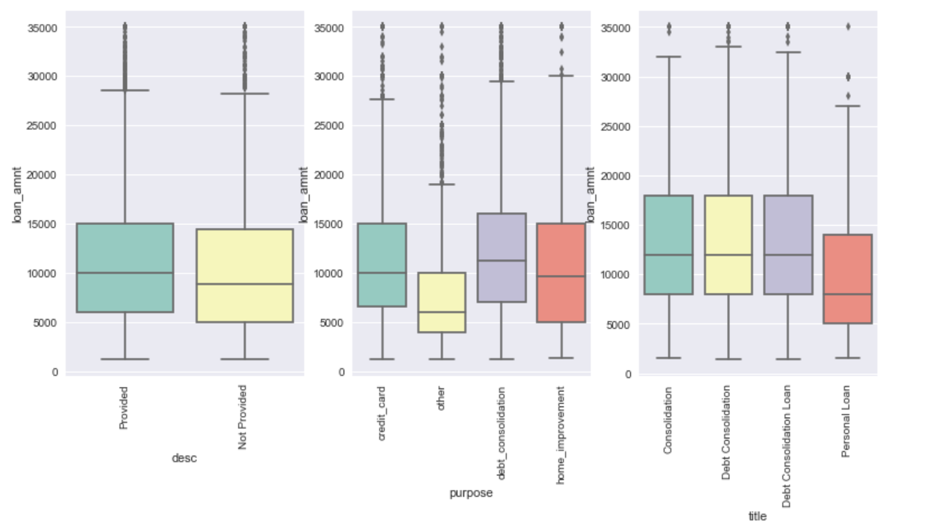
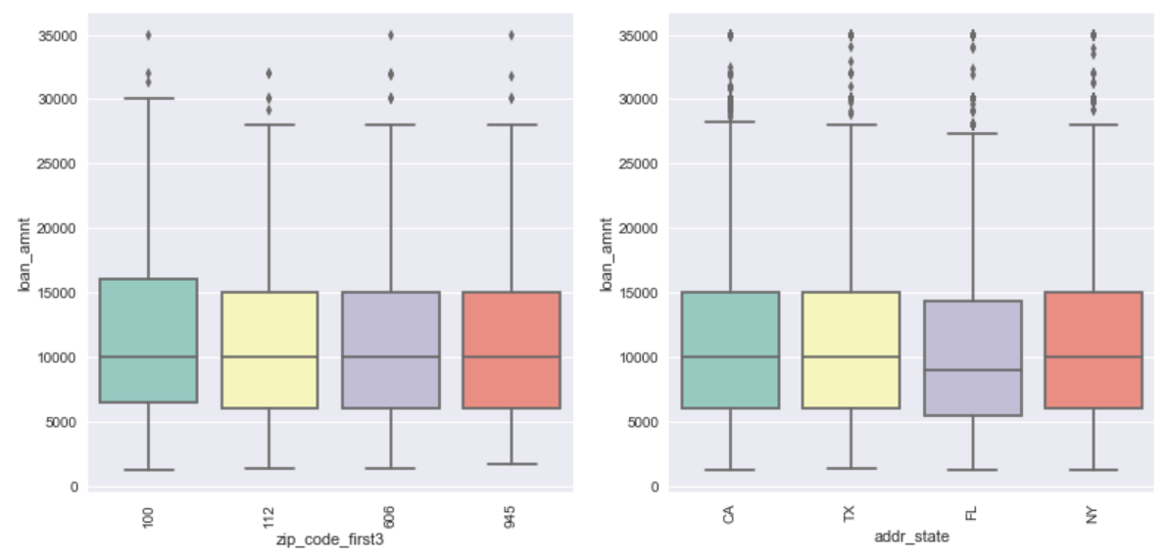
Segmented Univariate Analysis
Desc: There is no significant difference in loan amount on Desc
Purpose: Credit_card, Other, Debt_Consolidation, Home_improvement are the top 4 Purpose. Out of these top 4 Debt_consolidation and Home_Improvement have higher range of loan amount
Title: No Significant information.
Zip_code (first 3 letters) : There is no significant difference in loan amount on zipcode
Addr_state : There is no significant difference in loan amount on addr_state

Slide 11
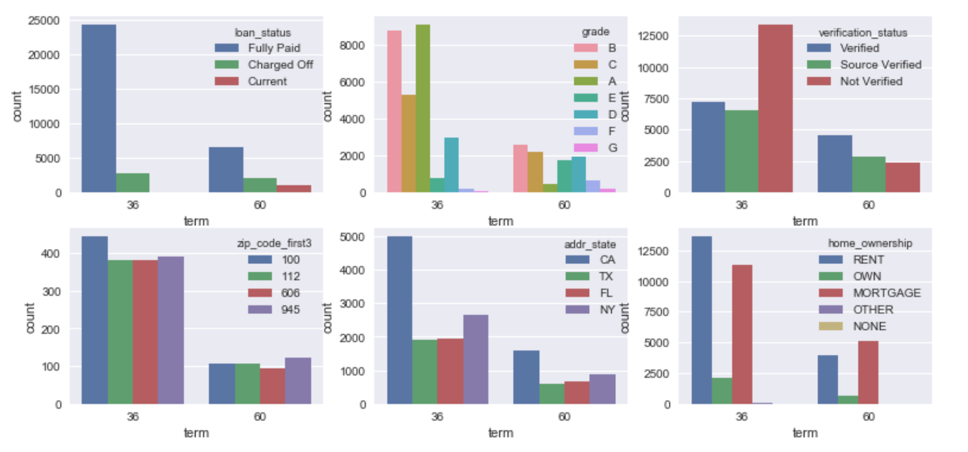
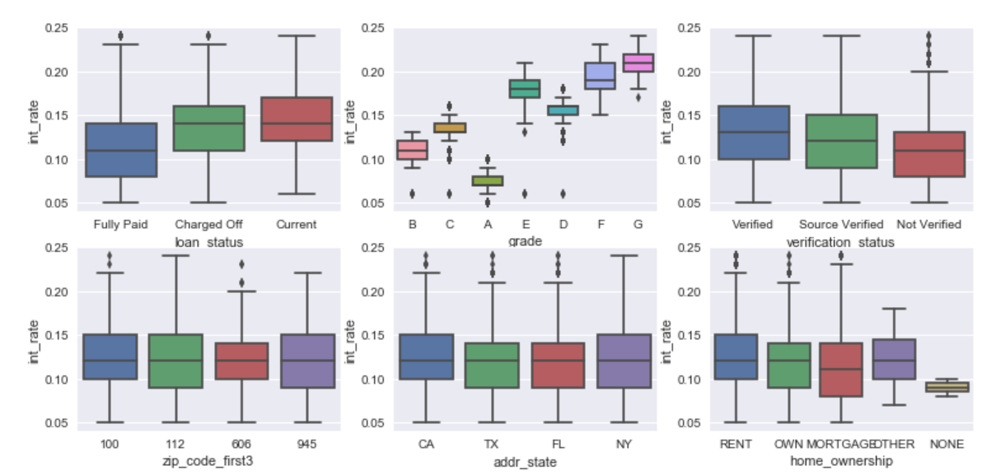
Segmented Univariate Analysis
Loan Status: The average int_rate is higher for loans with status 'Charged Off'
Grade: The average int_rate for loans with Grade A is lower compared to other grades. Interest rates increase with the Grades A, B, C, D, E, F, G in the same order
Verification status: int_rate is lower for loan verification_status 'Not Verified' compared to 'Verified’
Loan Status: The average int_rate is higher for loans with status 'Charged Off' 2. Grade: The average int_rate for loans with Grade A is lower compared to other grades. Interest rates increase with the Grades A, B, C, D, E, F, G in the same order 3. Verification status: int_rate is lower for loan verification_status 'Not Verified' compared to 'Verified’
Loan Status: Most of the Term 36 have loan status 'Fully Paid'

Slide 12
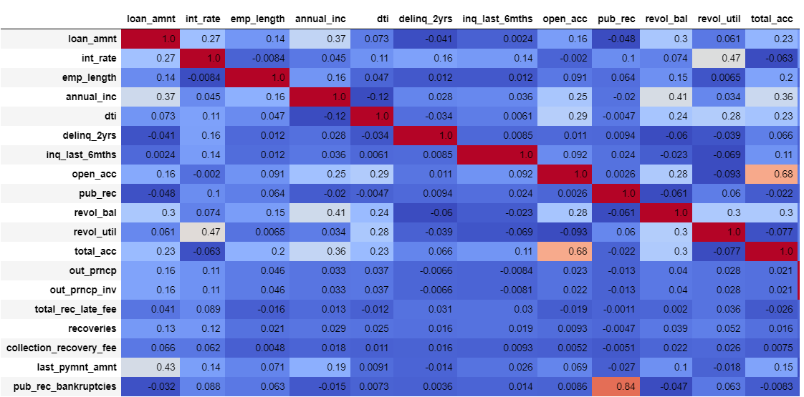
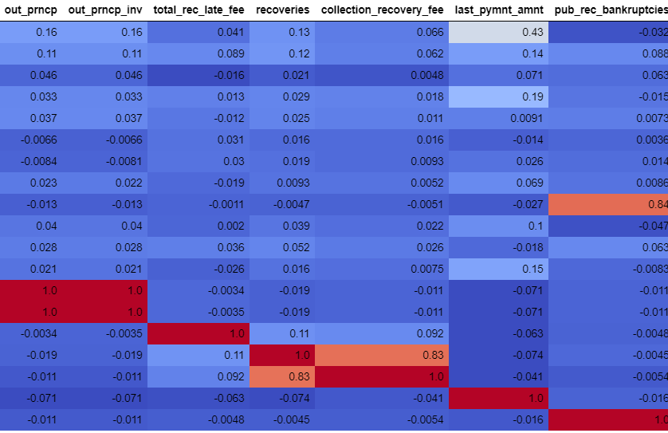
Bivariate Analysis
Correlations of continuous variables shows that Loan amount has a vey low correlation with dti (the ratio calculatd by the monthly debt payments divided by the monthly income) Loan amount is negatively corelated to the number of derogatory public records.

Slide 13
Conclusions
The most important drivers for loan defaulters are
Consumer Attributes – Employee Length, Grade, Home Ownership
Loan attributes – Verification status, delinquency in past 2 years, repayment status

